Slide 1

Project Details:
Project Title - Forecasting Air Quality Using Historical Pollution Data Project
Purpose-Predict air quality index (AQI) and pollutant levels using historical pollution data. Help authorities, planners, and the public take preventive actions and make healthier decisions.
Provide alerts, dashboards, and trend analysis for better environmental management.
Tools and Technologies - Python, Streamlit
Mentor - Ms. Umme Asma S
Batch Number – 3
Start Date - 22-September-2025 Intern Name – K.Sri Sahithya
GitHub Repository - https://github.com/sahithya17b/Air-Quality

Slide 2
VISION STATEMENT
To create a cleaner, healthier, and sustainable environment by enabling real-time, data-driven awareness of air pollution and empowering communities and authorities to take proactive action.
MISSION STATEMENTS:
To monitor, analyze, and forecast air quality using advanced data science and predictive modeling, delivering accurate and accessible insights that support informed decision-making and pollution control.”
Alternate professional missions:
To provide a reliable platform that measures key pollutants, detects trends, and predicts AQI levels using machine learning and real-time sensors.”
To support governments, researchers, and citizens by offering transparent, easy-to-understand air quality information derived from scientific data processing.”
“o reduce pollution impact by enabling early warnings, hotspot detection, and pollution source analysis through automated data pipelines.”

Slide 3
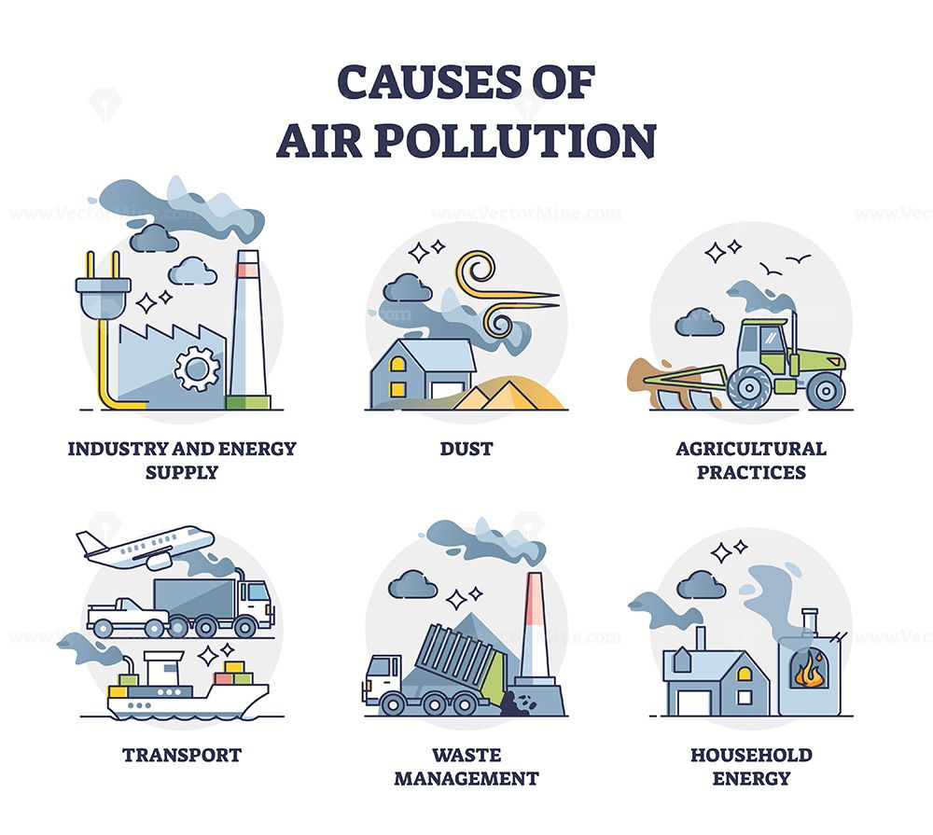
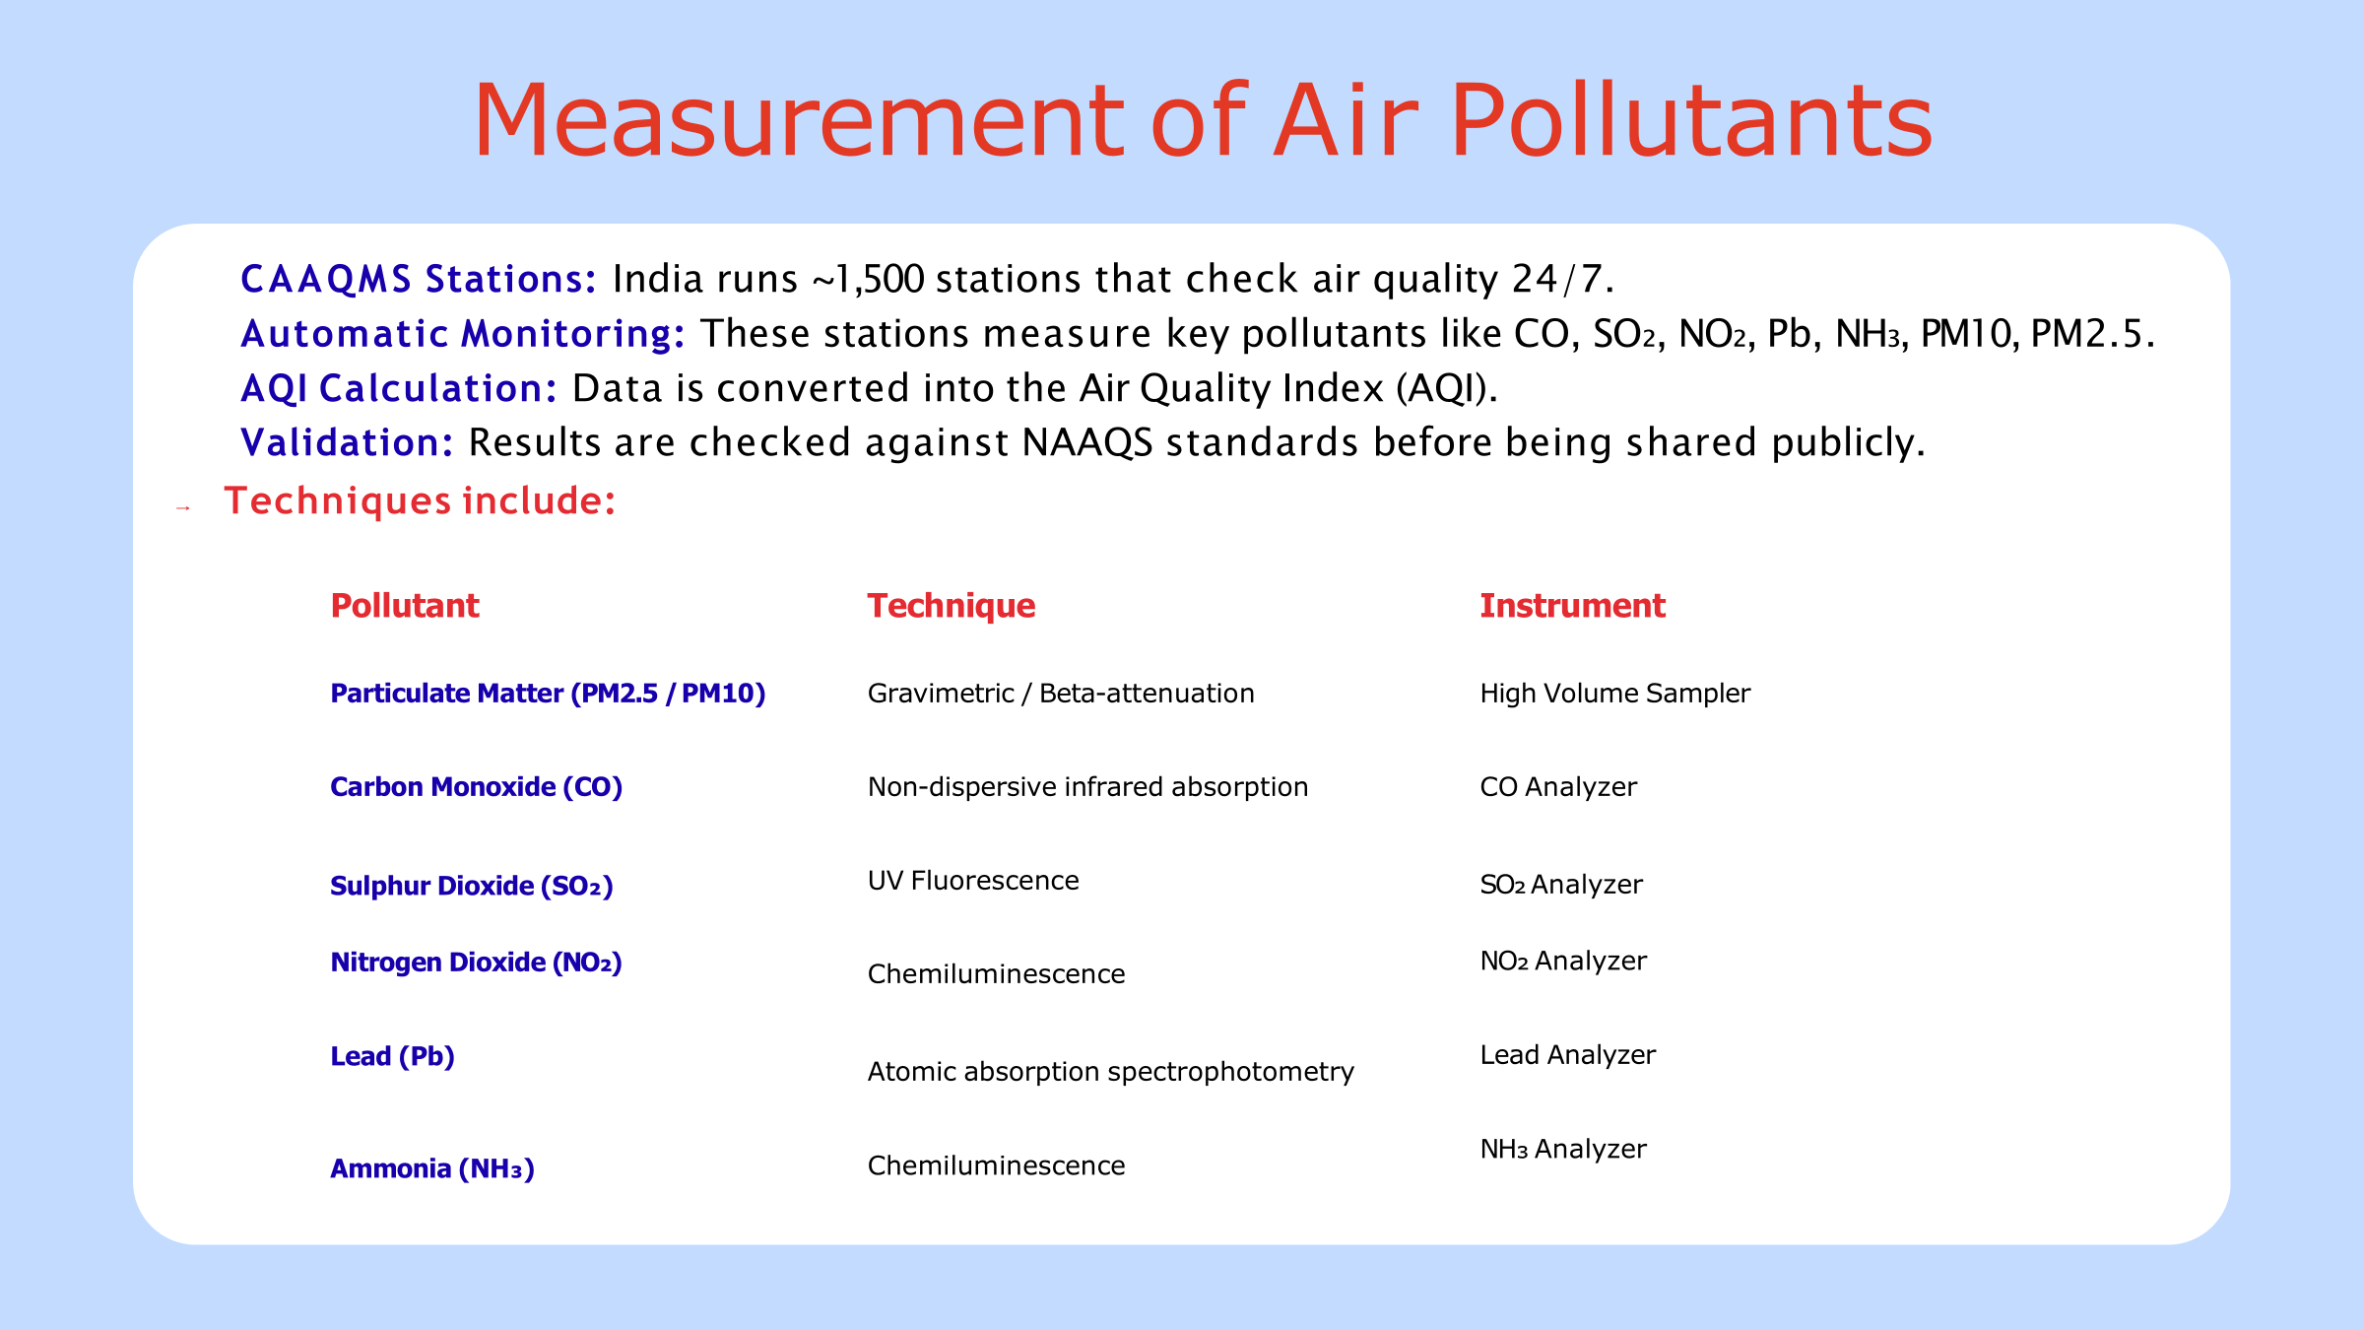

Slide 4

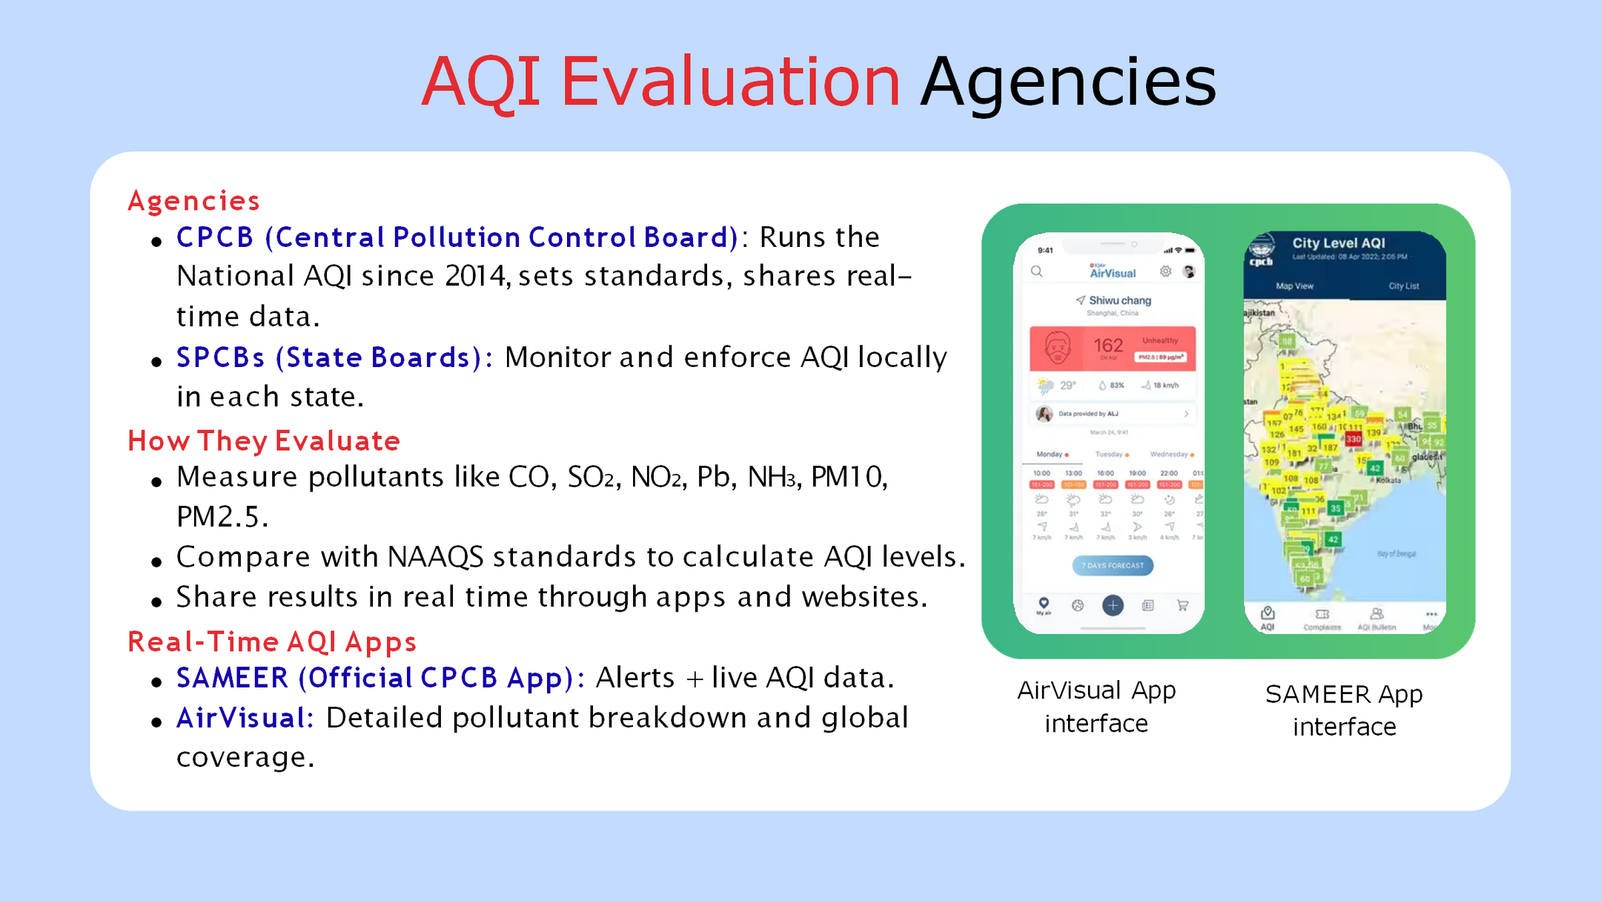

Slide 5
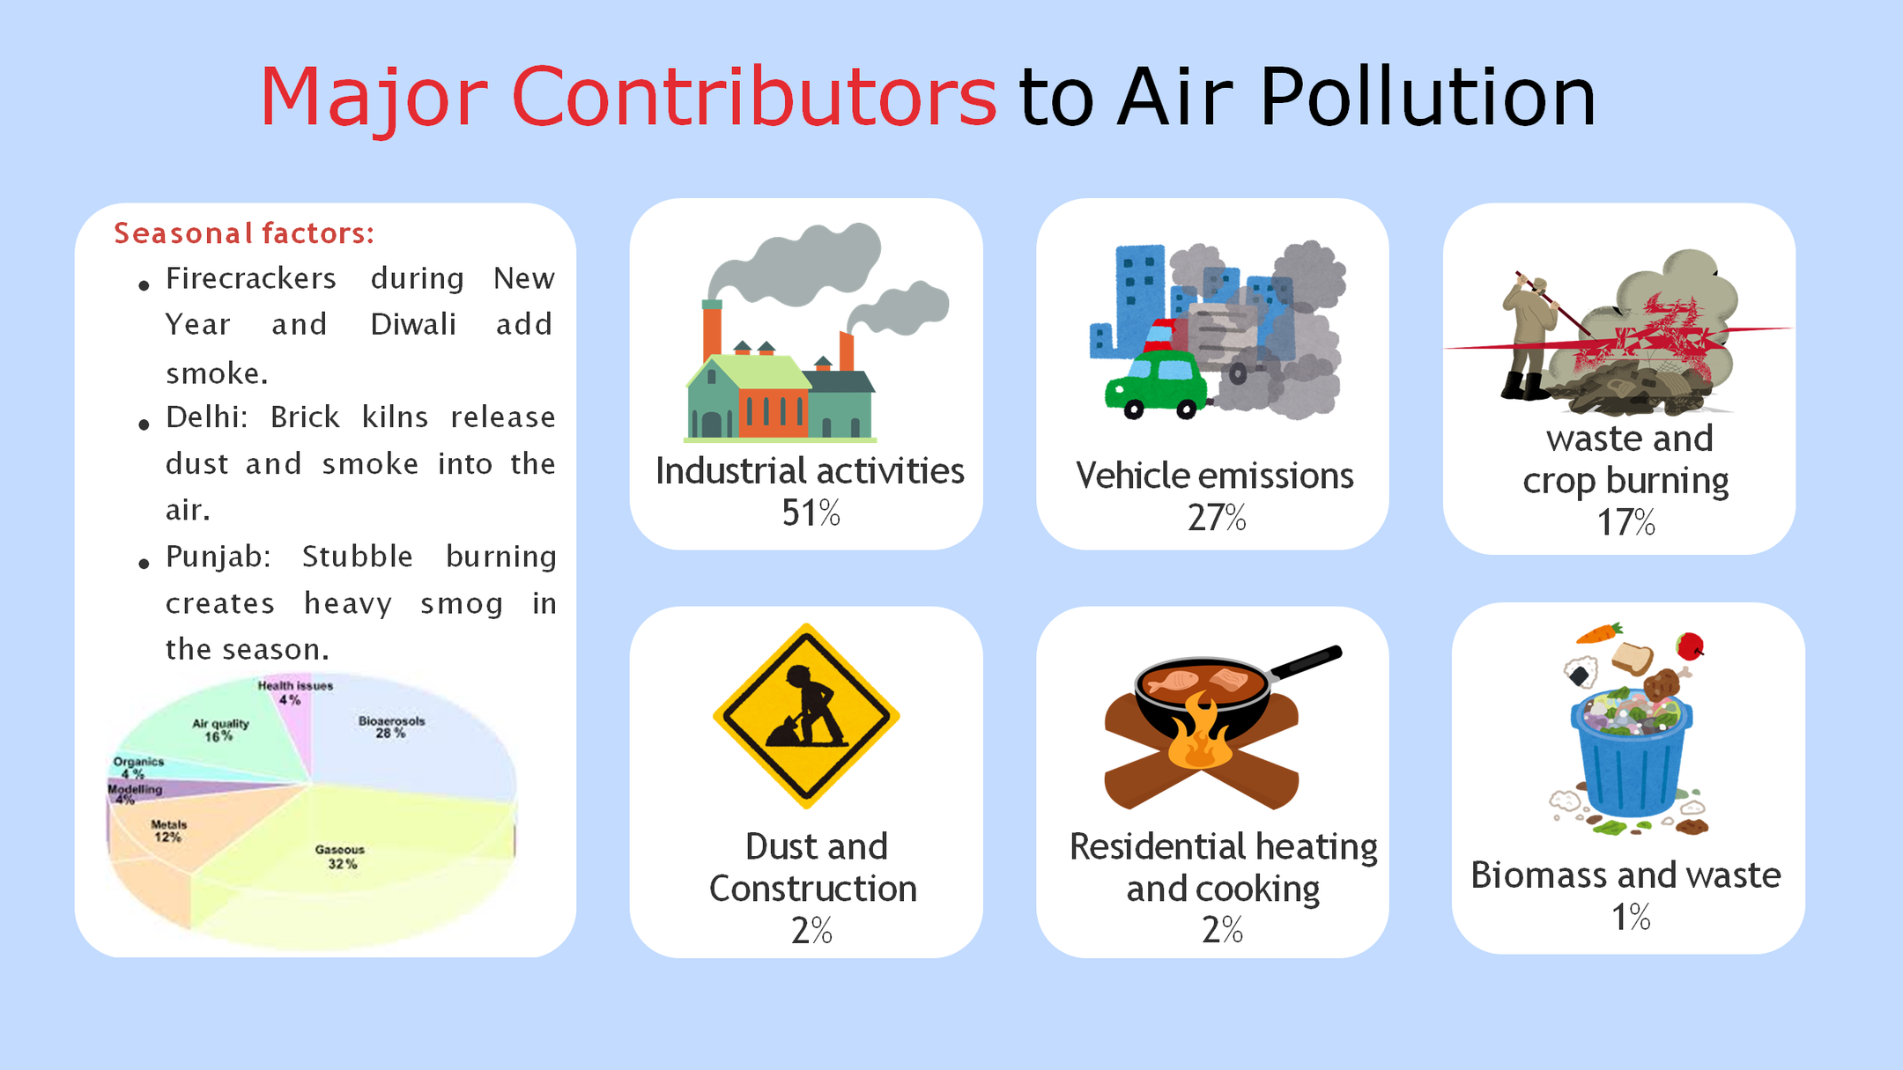


Slide 6
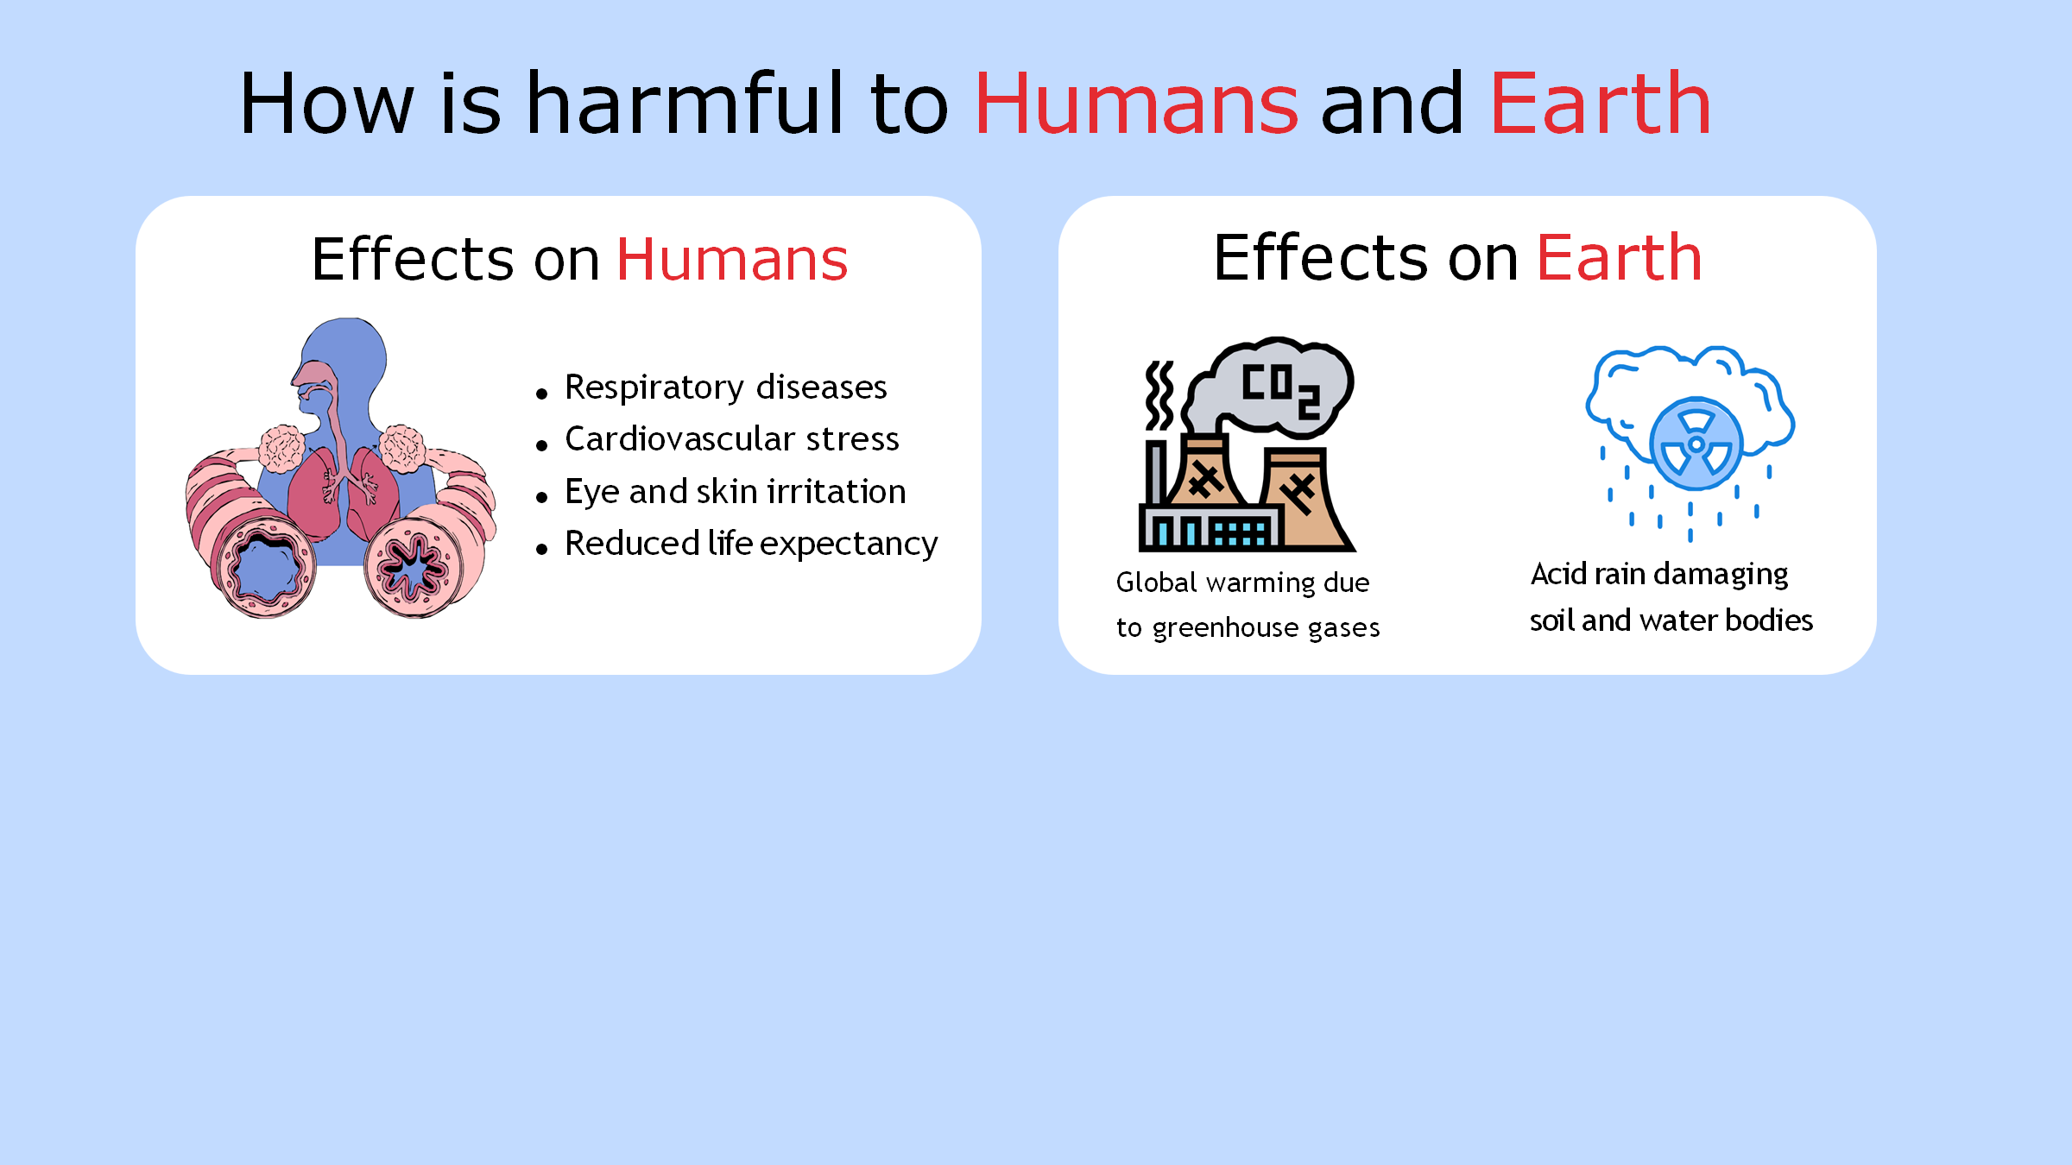


Slide 7

The air quality in the national capital continued to remain in the ‘severe’ category on Wednesday morning (November 12, 2025) for the second day since it worsened for the first time this season, as per official data. This comes a day after the Graded Response Action Plan (GRAP)-III was invoked across Delhi and the National Capital Region (NCR).
Breaching the 400-mark across multiple monitoring stations, Delhi’s 24-hour average air quality index (AQI) was 414 at 9 a.m., as per the Central Pollution Control Board (CPCB).
Among all monitoring stations, Wazirpur recorded the highest AQI of 459, categorised as ‘severe’ air quality, while NSIT Dwarka monitoring station recorded an AQI of 215, categorised as ‘poor’ air quality.

Slide 8
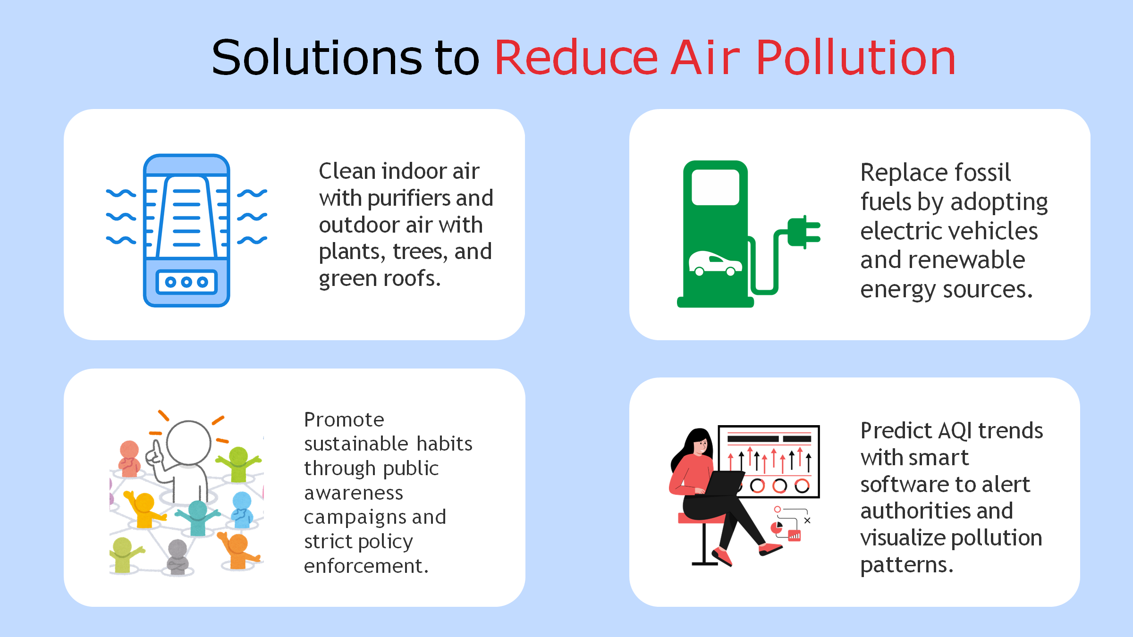


Slide 9



Slide 10

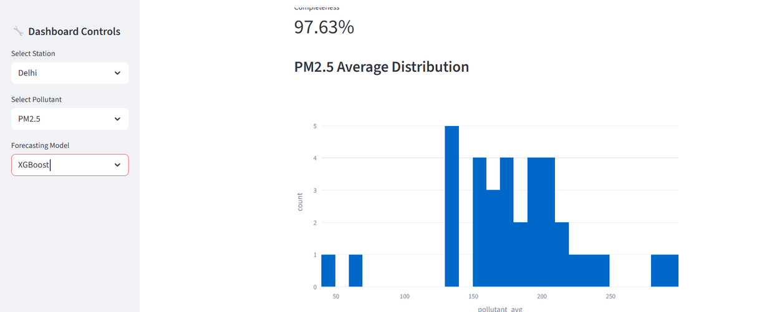
GENERATED DASHBOARD SAMPLES

Slide 11
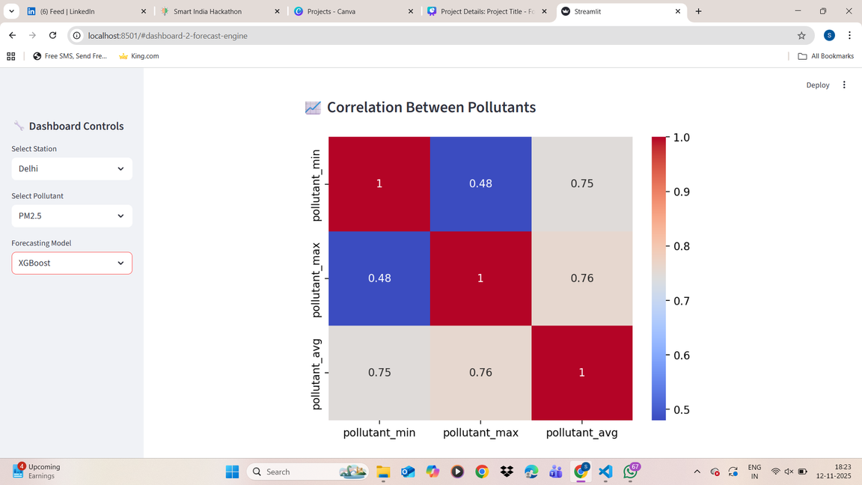
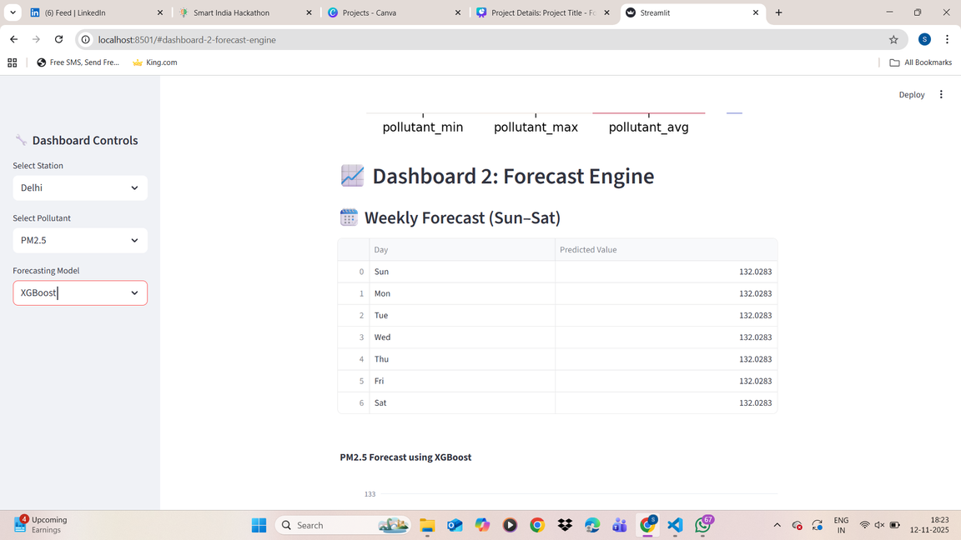
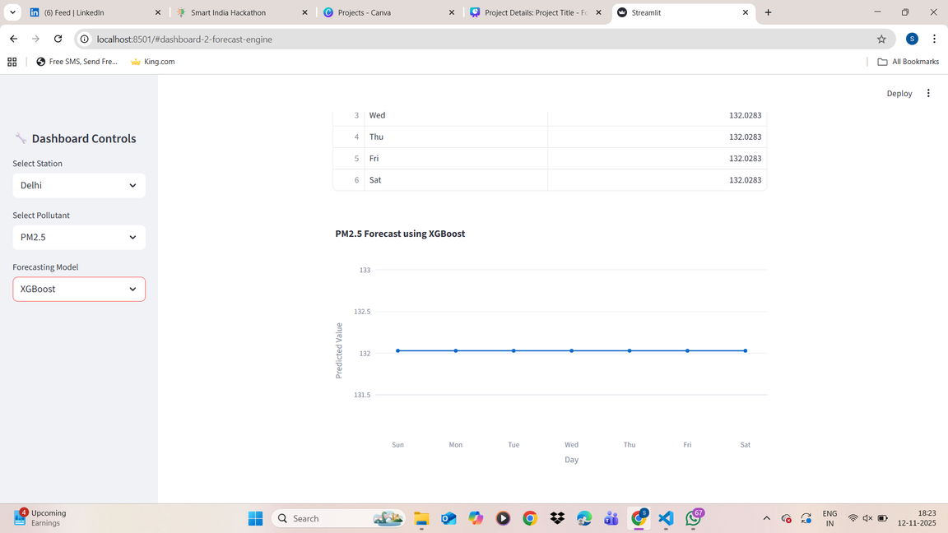
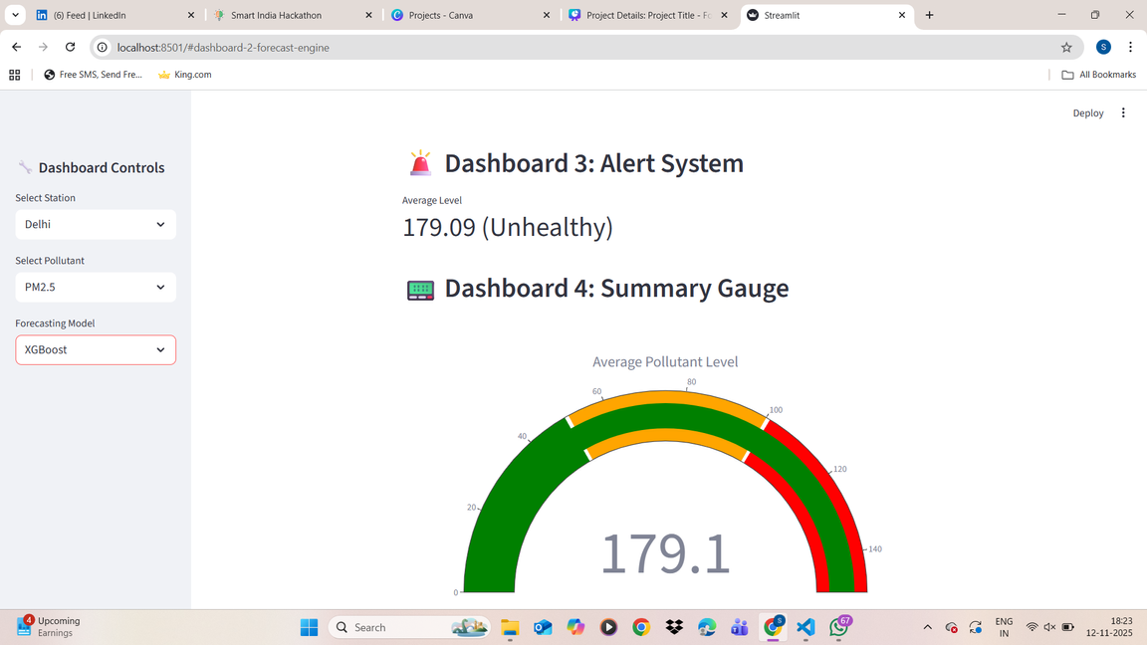

Slide 12

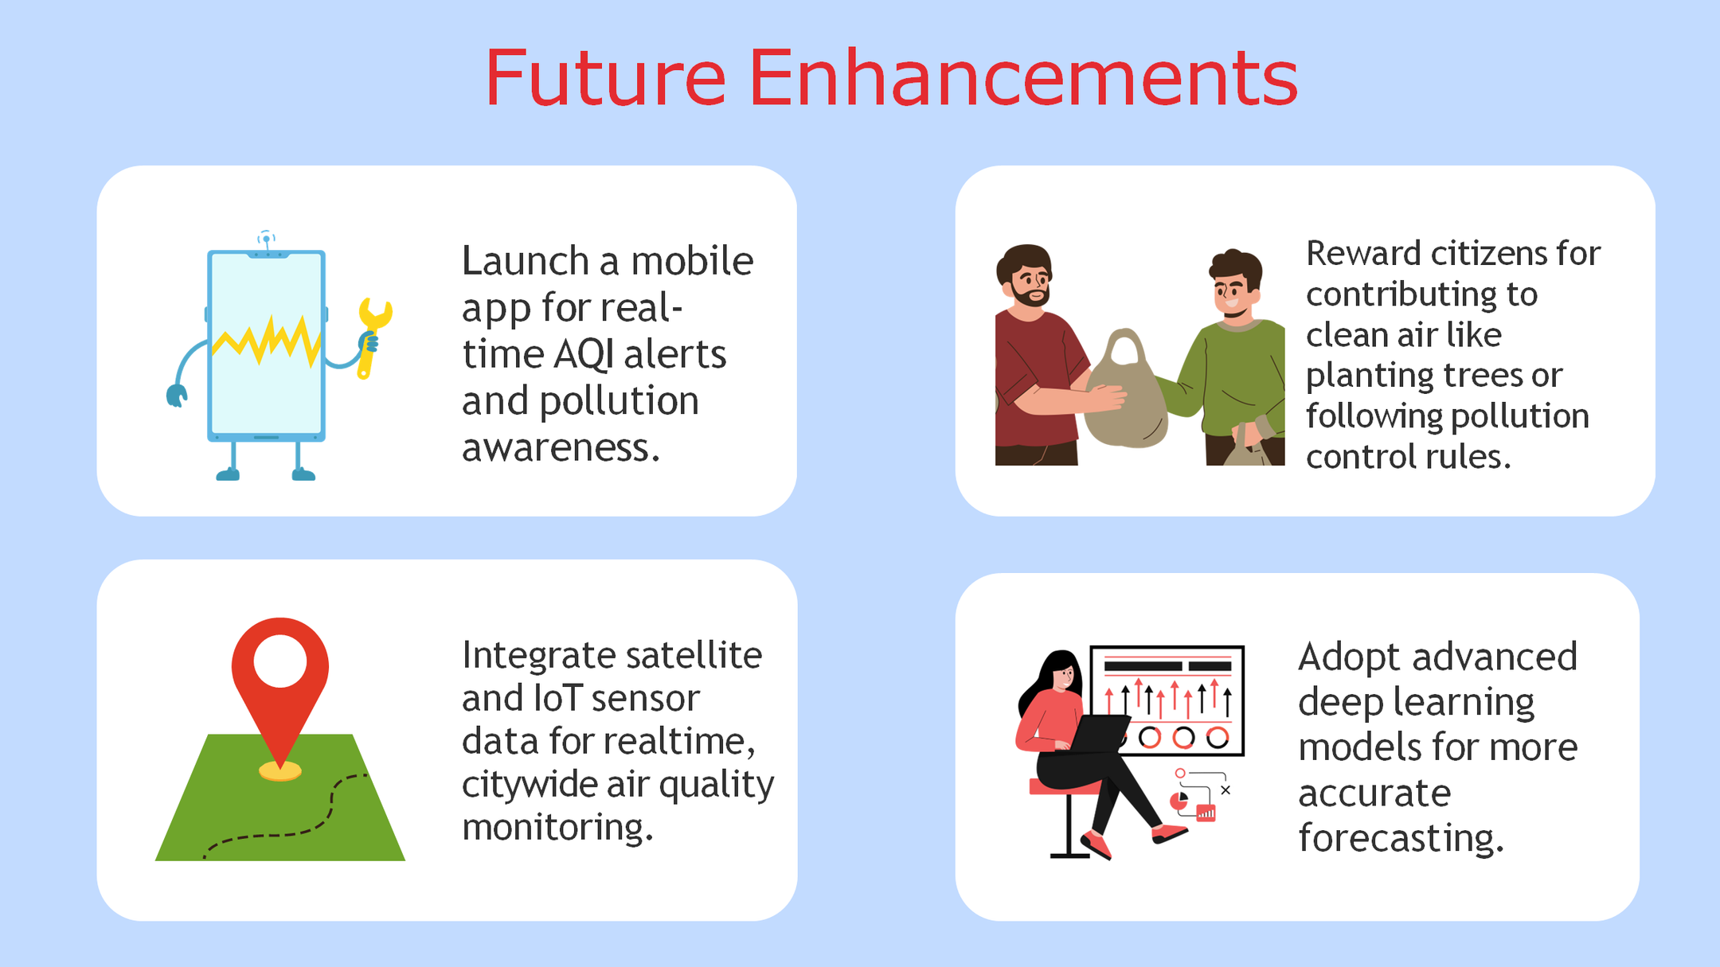

Slide 13
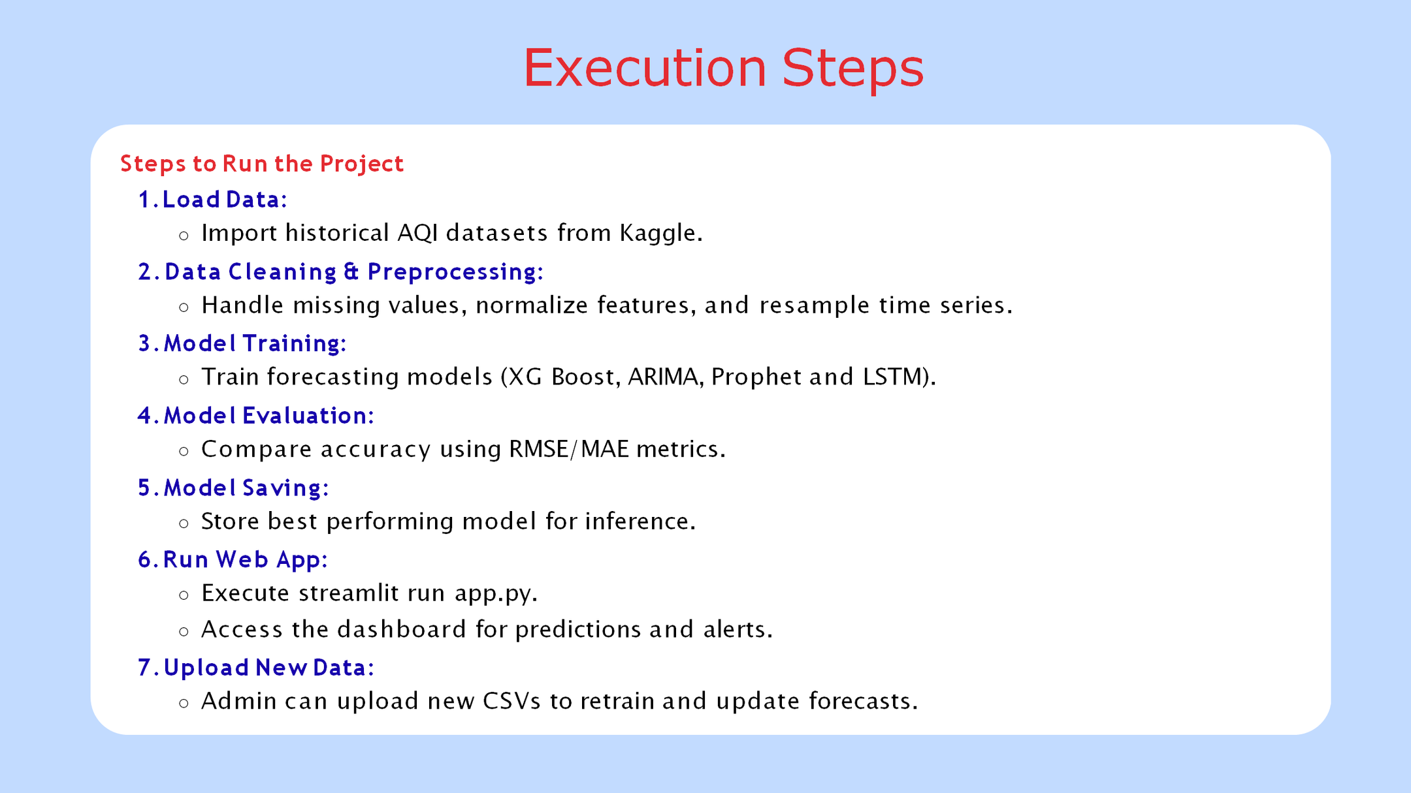

Slide 14

“Be a part of the solution, not part of the pollution."

